Slide 1
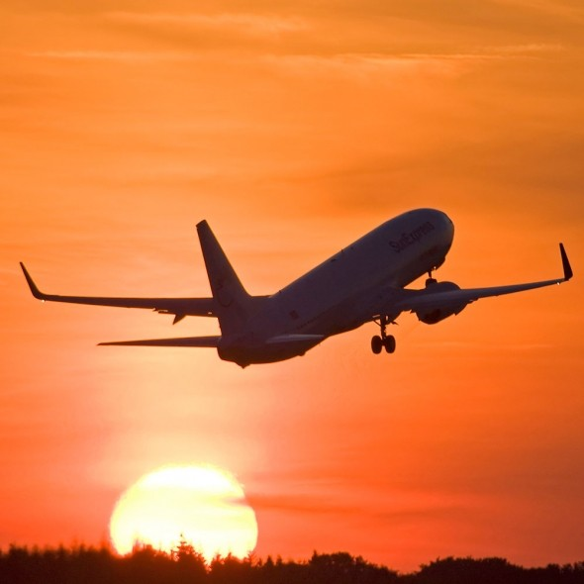
Who Loves Flying ?
A Sentiment Analysis using Tweets
Stuti Sharma
Seattle Pacific University

Slide 2
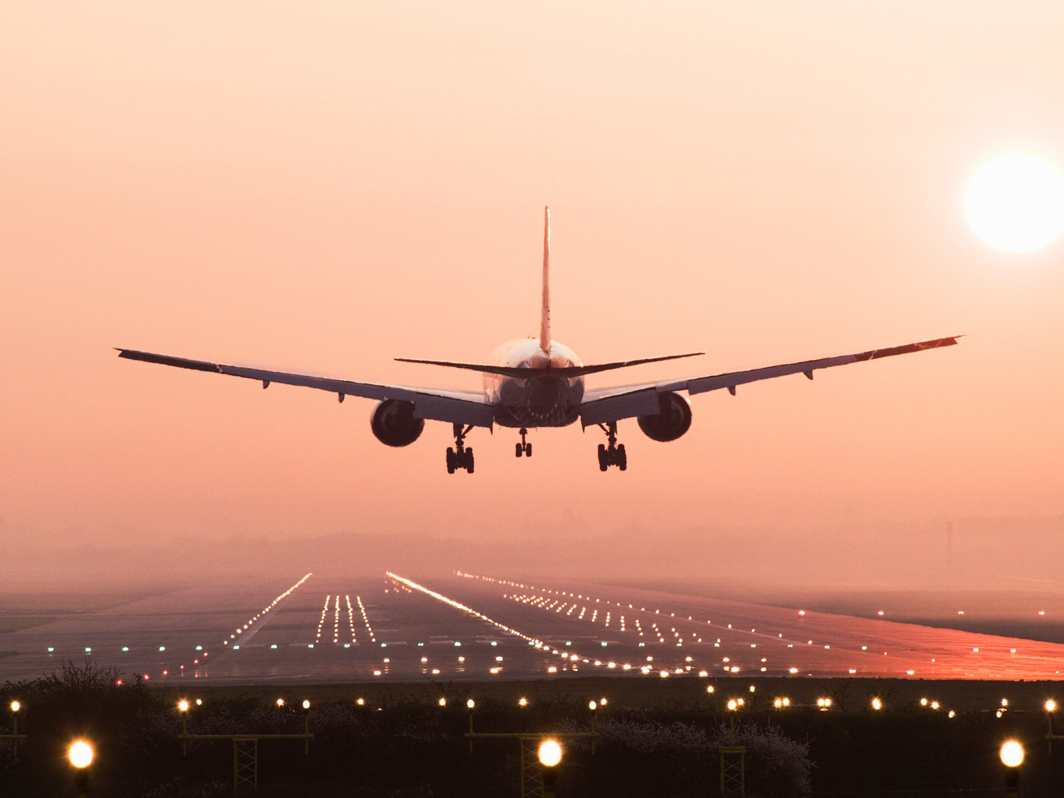
Outline
Data Review
Exploring Trends
Data Preparation
Algorithms
Clustering
Association-Rule
Conclusion
Decision Tree
Naïve Bayes
Random Tree
K-NN

Slide 3


Data Review
Source
Kaggle
About
Air Travelers Tweets
Tweets
2932
Sentiments
Positive & Negative
Airlines
Delta & Southwest
Attributes
Sentiment (label)
Airline
Passenger_Name
Retweet_Count
Tweet
Passenger_Timezone
Problems with Data
Missing Data
Spelling Mistakes
Punctuation Errors
Abbreviations
Sarcasm
Out of Context

Slide 4
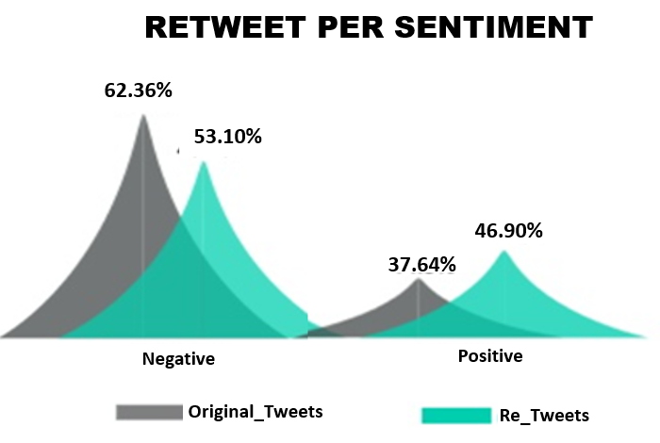

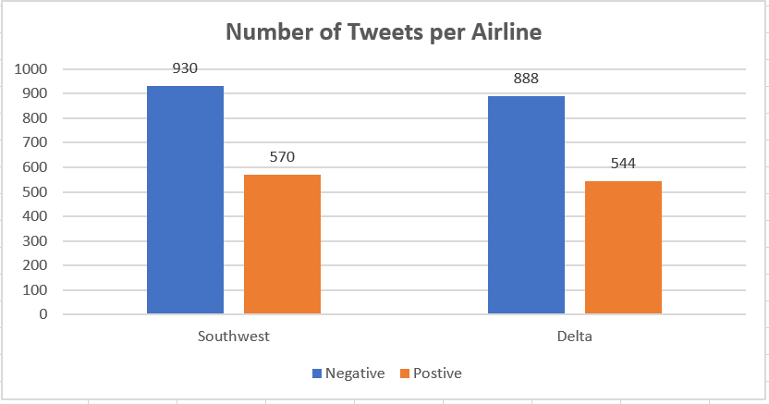
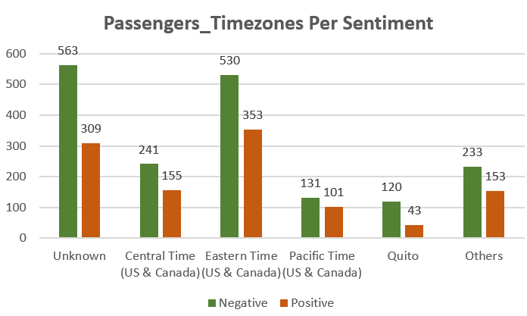
Exploring Trends
@SouthwestAir my flight was delayed 4 hrs. I'm 5 months pregnant &amp; supposed to be caring for my mom whose in surgery now. Very upset.
@JetBlue I will. I love flying with you all. Great service.

Slide 5

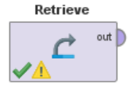
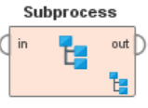
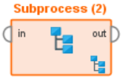
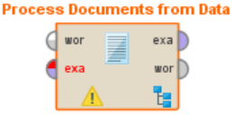
Data Cleanup
Loads the Dataset from the RaipMiner’s Repository
Collection of Processes inside a Process
Generates Word Vector from String Attributes

Slide 6
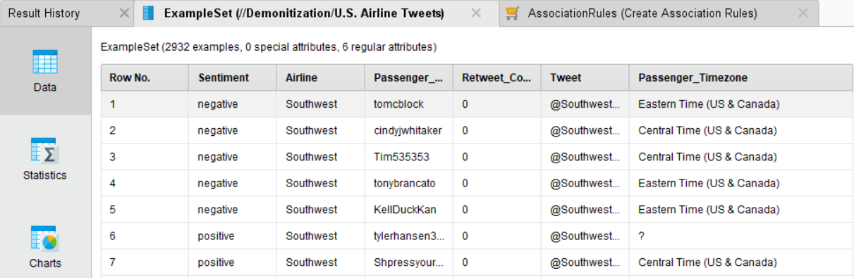
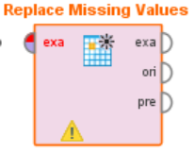
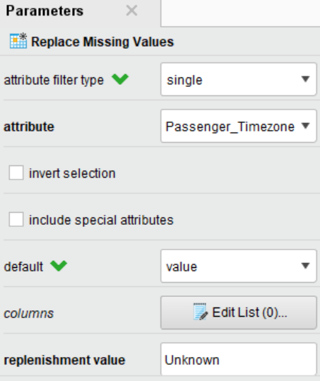
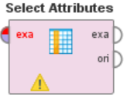
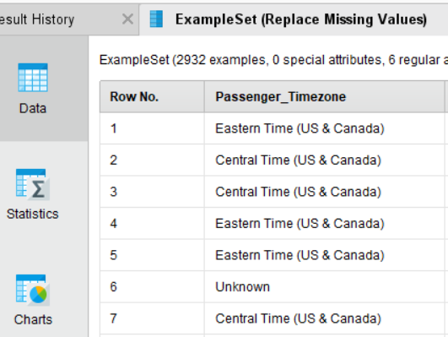
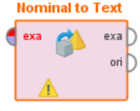
Subprocess 1

Slide 7
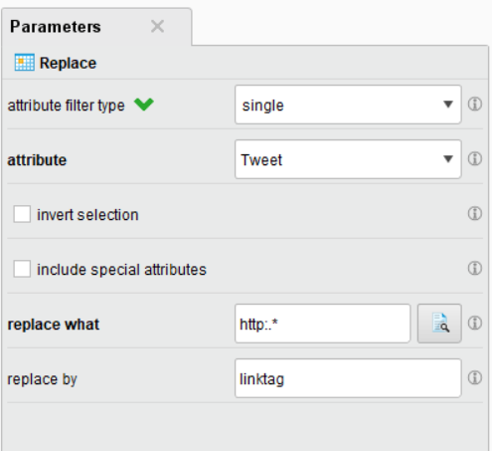
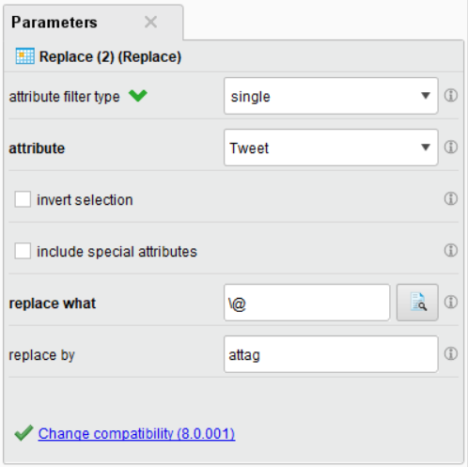
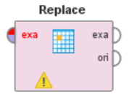
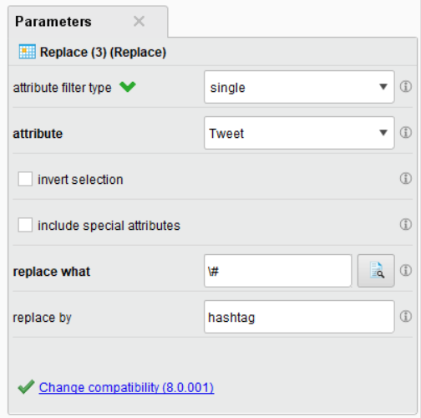
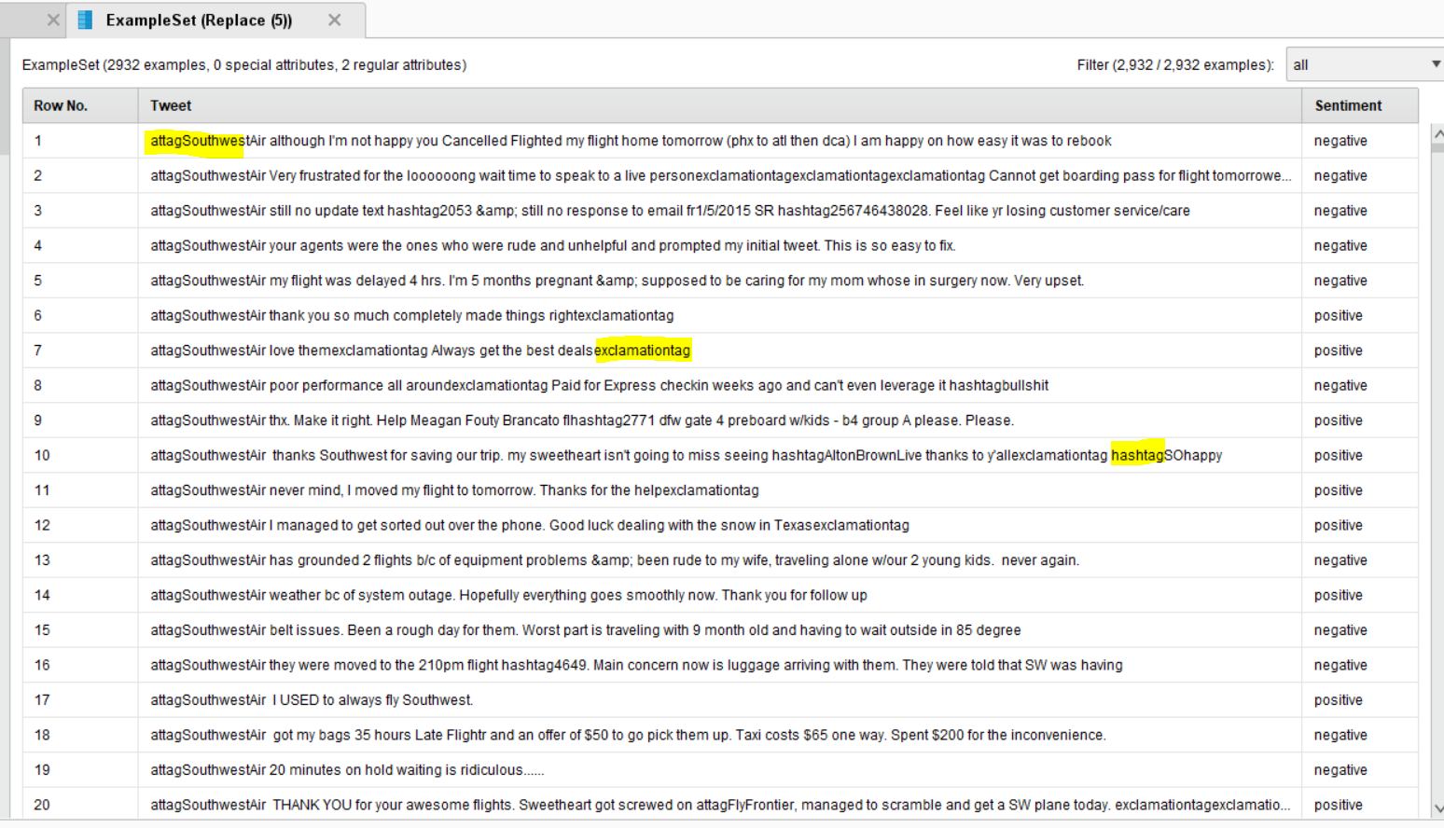
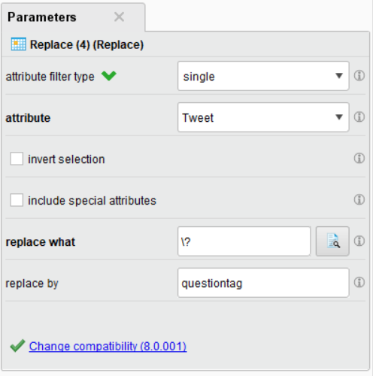
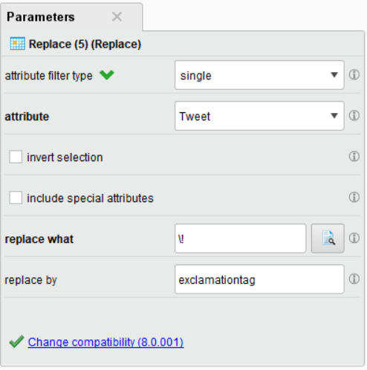
Subprocess 2

Slide 8
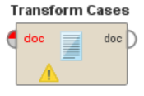
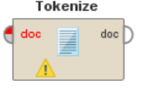
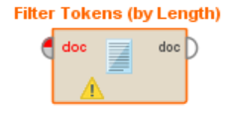
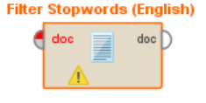
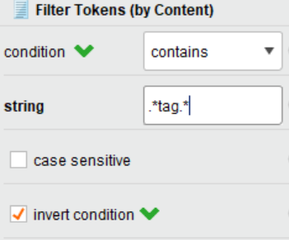
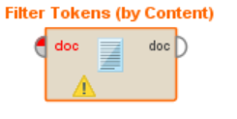
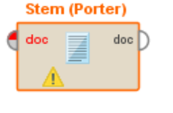
Process Document from Data
Convert to one case e.g. Lower Case
Split the text into Tokens (Select Mode: non-letters)
Token length: 3-25 characters in a token
Removes English stop words e.g. then, that, this, the
Reduce the suffix of word to get accurate matching stem. E.g. “happy”, ”Happier”, ”Happiest” → Stem: Happy

Slide 9
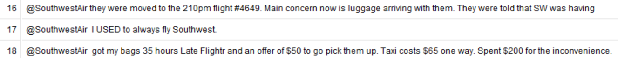

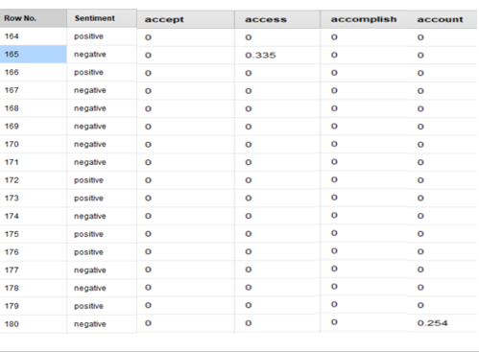
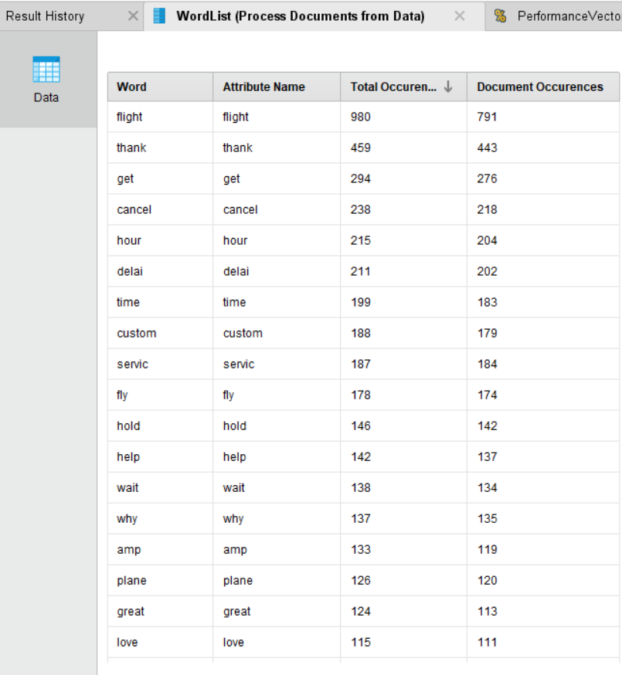

Slide 10
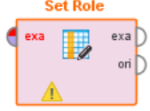
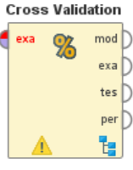
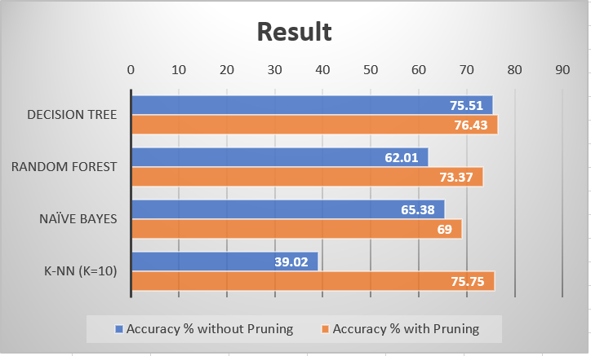
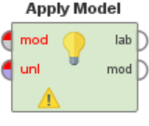
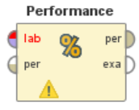
Data Preparation
Algorithms
Algorithms:
Decision Tree
Random Forest
Naïve Bayes
K-NN
Test Dataset

Slide 11
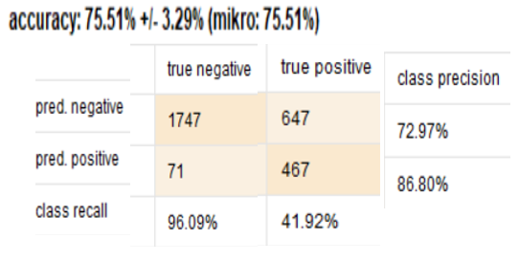
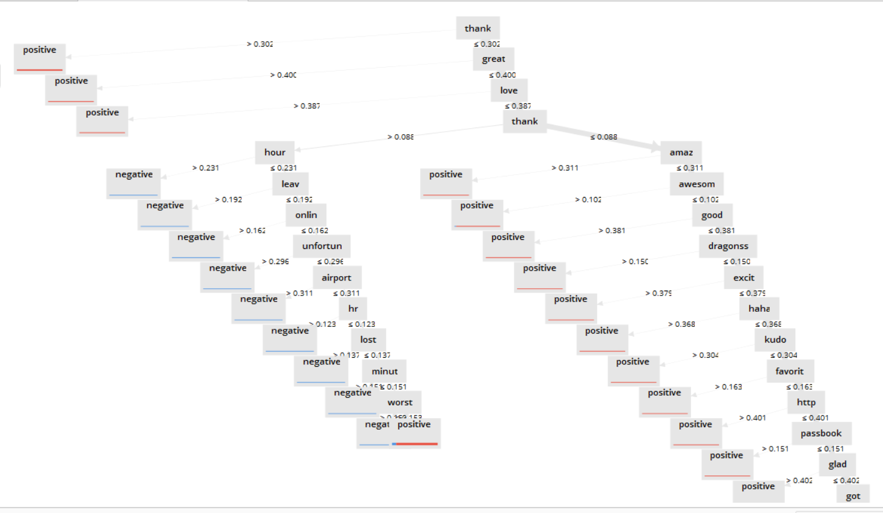


Decision Tree
@JetBlue Awesome thanks! Thanks for the quick response. You guys ROCK! :)
@SouthwestAir I was on hold for 2 hours and my call got disconnected. Thanks a lot.

Slide 12
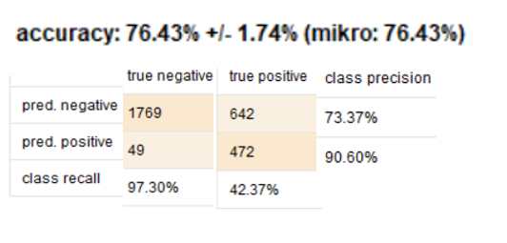
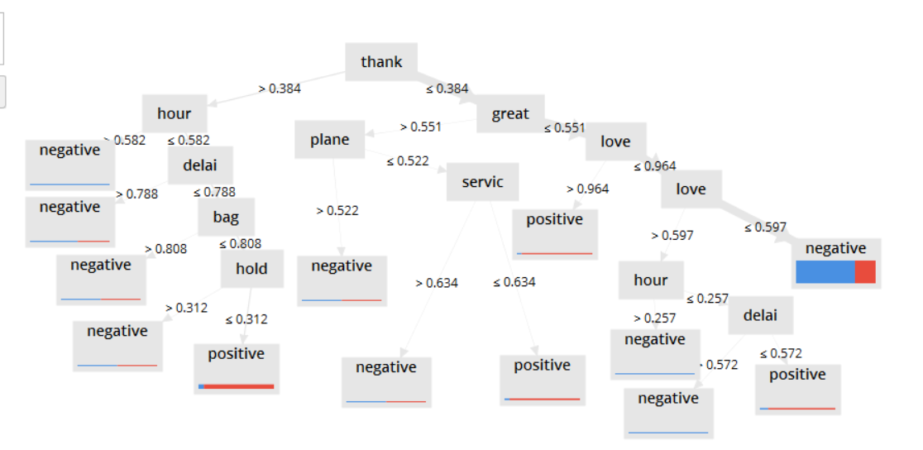
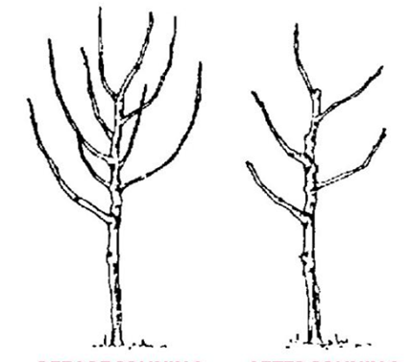
Decision Tree
(With Pruning)

Slide 13

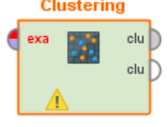
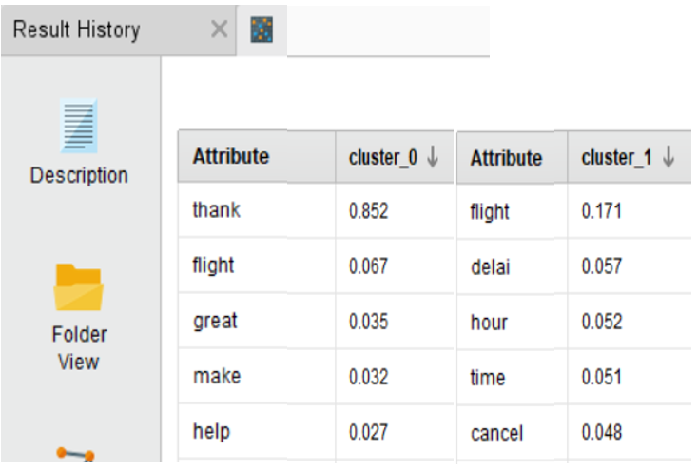
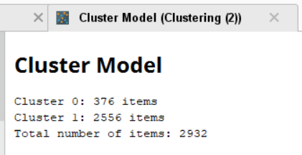
Clustering
Centroid Table
K-Means (K=2)

Slide 14
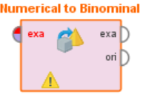
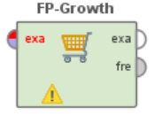
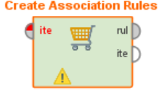
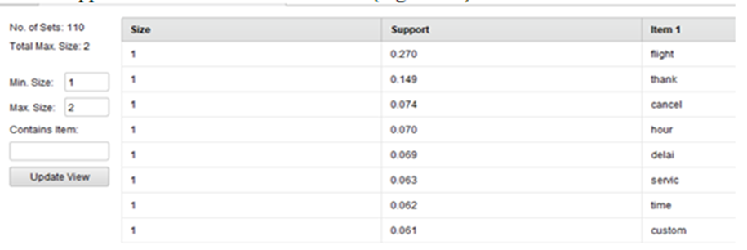
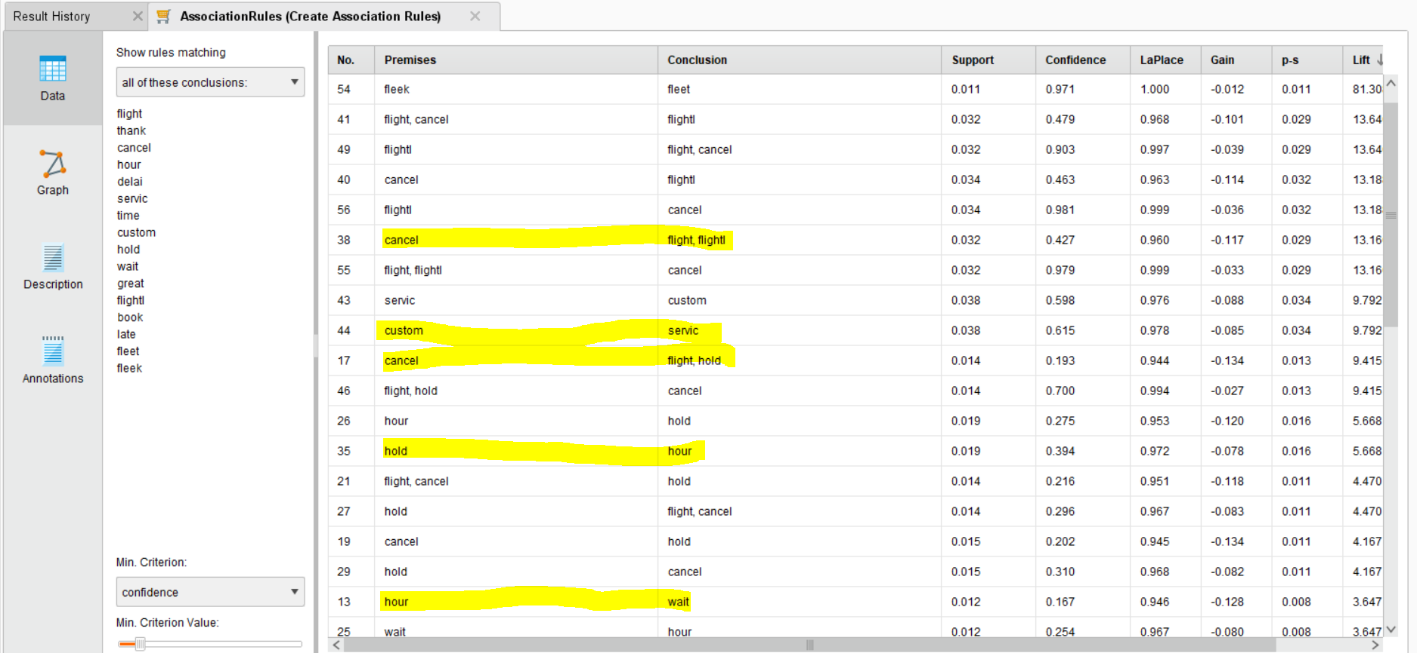

Association-Rule
Data Preparation

Slide 15





Slide 16

What went well
Balanced dataset
Spent 90% of time in Data Preparation
Referred to plenty of YouTube tutorials and peer-reviewed articles
What Did NOT go Well
Data limits- Twitter
Selection of dataset
Text data:
Limited choice of algorithms
Cleaning text data-Challenging
Next Time
Spend more time understanding data
Feature generation
WordNet Dictionary
Rich Linguistic analysis – Parsing, semantic analysis and POS tags

Slide 17

References
Ertek, G., Tapucu, D., & Arin, I. (2013). Text mining with rapidminer. RapidMiner: Data Mining Use Cases and Business Analytics Applications, 241.
Hu, G., Bhargava, P., Fuhrmann, S., Ellinger, S., & Spasojevic, N. (2017). Analyzing users' sentiment towards popular consumer industries and brands on Twitter. arXiv preprint arXiv:1709.07434.
Kharde, V., & Sonawane, P. (2016). Sentiment analysis of twitter data: A survey of techniques. arXiv preprint arXiv:1601.06971.
Wills, R. K. (2012). Efficient Sentiment Analysis of Feeds for Rapid User Information Gain.
Yuan, P., Zhong, Y., & Huang, J. Sentiment Classification and Opinion Mining on Airline Reviews.
YouTube Videos Links:
https://www.youtube.com/watch?v=kFGronMuchU
https://www.youtube.com/watch?v=K7AgCas0gJ0
https://www.youtube.com/watch?v=kq61oFXD4YI

Slide 18


